Slide 1
Efficient Data Collection

Slide 3
How can we be more efficient?
Data (Re)organization
Project
Planning
Data Collection
Data
Entry
Data
Correction
Data Organizing for Analysis
Data Analysis
More Data Correction
How much data?
What data?
How do we collect it?

Slide 4
Effort now saves time, money, & stress later.

Slide 5
Where can errors be introduced?

Slide 6

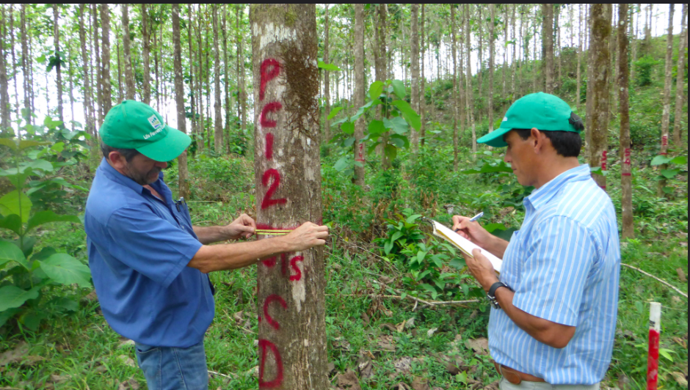

Slide 7
How can we minimize them?
2 opportunities to introduce error
(more next week)
Write on paper
Enter into computer

Slide 8

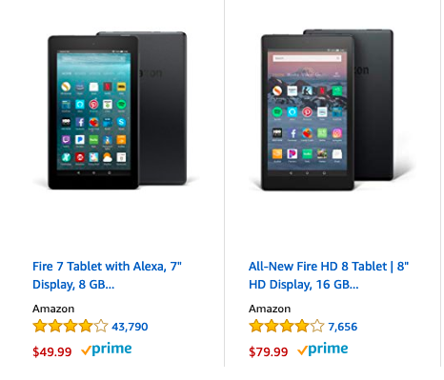
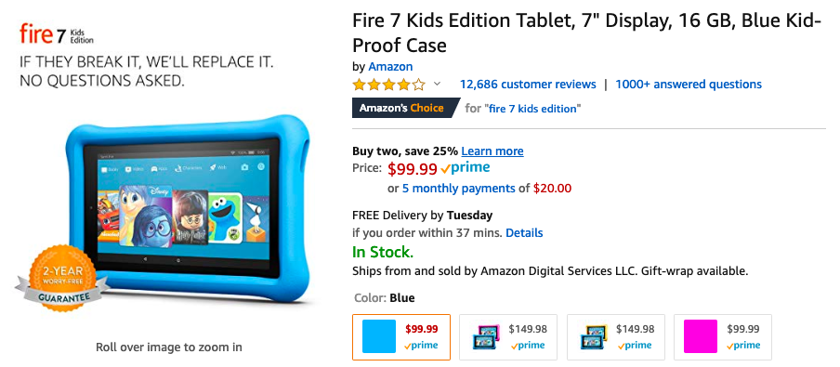

Slide 9
What are pros and cons of digital vs. paper data collection?

Slide 10
Scribe reads out incorrect number of tree he wants measured
Scribe reads out correct number of tree he wants measured but assistant hears wrong number
Scribe reads the number of the tag or tree incorrectly (so ‘correct’ measurement is recorded, but for a tree different from the one the scribe wanted).
Scribe incorrectly measures tree (doesn’t know how to use dbh tape, knows how to use it but makes a mistake, measures tree in the wrong place, tape is poor quality, different brand tapes at different times, measures to wrong level of precision)
Scribe writes down incorrect value
Scribe writes down illegible value
Fail to record data you need (gps points, plot, number)
8. Misidentify species
9. Write down incorrect species
10. Switch jobs and so record data inconsistently or incorrectly
11. Lose data sheet
12. Data sheet partially damaged

Slide 11
What are pros and cons of digital vs. paper data collection?

Slide 12
I’m stuck using paper…
what can I do?

